Slide 1
Recap of RNN / LSTM / GRU

Slide 2



Recap - RNN Architecture
ŷ₁
ŷ₂
ŷ₃
1 0 0
input 1
0 1 0
input 2
0 0 1
input 3
timestep 1
timestep 2
timestep 3

Slide 3
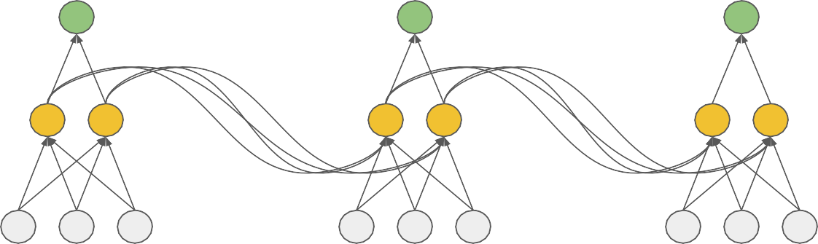
Recap - RNN Architecture
ŷ₁
ŷ₂
ŷ₃
1 0 0
input 1
0 1 0
input 2
0 0 1
input 3
timestep 1
timestep 2
timestep 3

Slide 4
Recap - RNN Architecture
ŷ₁
ŷ₂
ŷ₃
W
W
V
V
V
U
U
U
1 0 0
input 1
0 1 0
input 2
0 0 1
input 3
timestep 1
timestep 2
timestep 3

Slide 5
Recap - RNN Architecture Variants
ŷ₃
V
W
W
W
W
H₀
H₁
H₂
H₃
U
U
U
input 1
input 2
input 3
many-to-one

Slide 6
Recap - RNN Architecture Variants
Pronoun
Verb
Noun
V
V
V
W
W
W
W
H₀
H₁
H₂
H₃
U
U
U
She
likes
books
many-to-many

Slide 7
Recap - Forward Propagation in RNN
ŷ
V
W
W
W
H₀
H₁
H₂
H₃
U
U
U
x₁
timestep 1
x₂
timestep 2
x₃
timestep 3

Slide 8
Recap - Forward Propagation in RNN
H₁ = g( W.H₀ + Ux₁ )
W
H₀
H₁
U
x₁ timestep 1

Slide 9
Recap - Forward Propagation in RNN
H₁ = g( W.H₀ + Ux₁ )
W
H₂ = g( W.H₁ + Ux₂ )
W
H₀
H₁
H₂
U
U
x₁
timestep 1
x₂
timestep 2

Slide 10
Recap - Forward Propagation in RNN
H₁ = g( W.H₀ + Ux₁ )
W
H₂ = g( W.H₁ + Ux₂ )
H₃ = g( W.H₂ + Ux₃ )
W
W
H₀
H₁
H₂
H₃
U
U
U
x₁
timestep 1
x₂
timestep 2
x₃
timestep 3

Slide 11
Recap - Forward Propagation in RNN
ŷ = k( VH₃ )
H₁ = g( W.H₀ + Ux₁ )
W
H₂ = g( W.H₁ + Ux₂ )
V
W
W
H₀
H₁
H₂
H₃
H₃ = g( W.H₂ + Ux₃ )
U
U
U
x₁
timestep 1
x₂
timestep 2
x₃
timestep 3

Slide 12
Recap - Back Propagation in RNN
Loss (y vs ŷ)
ŷ
V
W
W
W
H₀
H₁
H₂
H₃
U
U
U
x₁
timestep 1
x₂
timestep 2
x₃
timestep 3

Slide 13
Recap - Back Propagation in RNN
Loss (y vs ŷ)
ŷ
V
W
W
W
H₀
H₁
H₂
H₃
U
U
U
x₁
timestep 1
x₂
timestep 2
x₃
timestep 3

Slide 14
Recap - Issues with RNN
Vanishing Gradient
RNN does not perform well for long sentences
Exploding Gradient
Gradients are large
Poor predictions

Slide 15
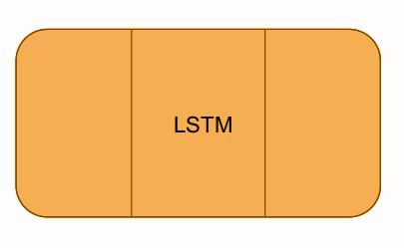
Recap - LSTM
Long Term Memory
1
2
3
^{C}t-1
Forget irrelevant information (forget gate)
^{H}t-1
C_{t}
Pass updated information (output gate)
H_{t}
Short Term Memory
add/update new information (input gate)

Slide 16
Recap - LSTM
Long Term Memory
1
2
3
^{C}t-1
Forget irrelevant information (forget gate)
^{H}t-1
C_{t}
Pass updated information (output gate)
H_{t}
Short Term Memory
add/update new information (input gate)

Slide 17
Recap - LSTM
Long Term Memory
1
2
3
^{C}t-1
Forget irrelevant information (forget gate)
^{H}t-1
C_{t}
Pass updated information (output gate)
H_{t}
Short Term Memory
add/update new information (input gate)

Slide 18
Recap - LSTM
Long Term Memory
1
2
3
^{C}t-1
C_{t}
Forget irrelevant information (forget gate)
Pass updated information (output gate)
^{H}t-1
H_{t}
Short Term Memory
add/update new information (input gate)

Slide 19
Recap - LSTM
Long Term Memory
1
2
3
^{C}t-1
Forget irrelevant information (forget gate)
^{H}t-1
C_{t}
Pass updated information (output gate)
H_{t}
Short Term Memory
add/update new information (input gate)

Slide 20
Recap - LSTM
Long Term Memory
1
2
3
^{C}t-1
Forget irrelevant information (forget gate)
^{H}t-1
C_{t}
Pass updated information (output gate)
H_{t}
Short Term Memory
add/update new information (input gate)

Slide 21
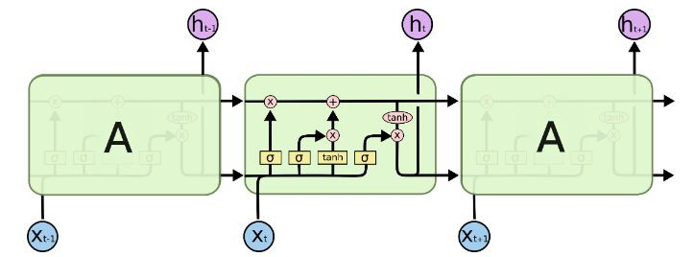
Recap - LSTM

Slide 22
Recap - GRU
Reset Gate (short-term memory)
Update Gate (long-term memory)
^{H}t-1
H_{t}
GRU
Simpler alternative to LSTM (fewer gates)
Faster training
x_{t}

Slide 23
Recap - CNN 1-D
d= 5
I
like
this movie
very
much
!
max pooled vector
sentence matrix
ﬁlters
feature maps

Slide 24

Projects
Auto-Tagging StackExchange Queries

Slide 25

Projects
Auto-Tagging StackExchange Queries
Web Traﬃc Forecasting

Slide 26
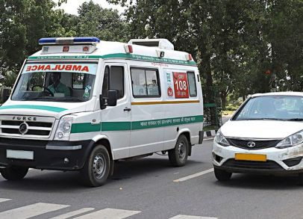
Projects
Auto-Tagging StackExchange Queries
Web Traﬃc Forecasting
Audio Classiﬁcation for Emergency Vehicle Detection

Slide 27
Thank You

